Slide 1
Health Disparities, Inequities, and Inequalities
Dr. Kimberly Henderson
March 15, 2023

Slide 2

Agenda
The Census
Terms and Definitions
The Landmark Report
Health Equity
Health Equity and You
Questions

Slide 3
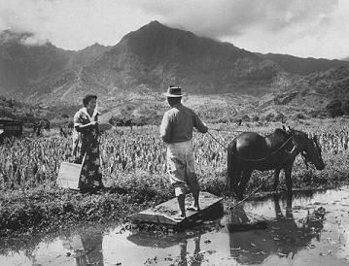
Race, Ethnicity, and the Census
The first census of the United States in 1790 had three racial groups: Whites, Blacks and Civilized Indians (those who paid taxes).
Parvanta, C., Nelson, D., & Harner, R. (2018). Public Health Communication Critical Tools and Strategies. Burlington, MA: Jones & Bartlett Learning, LLC

Slide 4
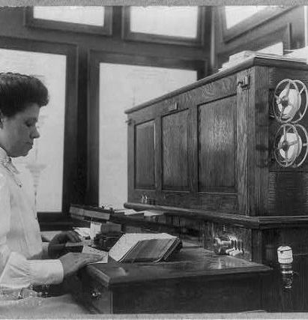
Race, Ethnicity, and the Census
the 1800 and early 1900s
During the 1800 and early 1900s: White, Black and Other Colored (Indians, Chinese and Japanese)
1930
Other was added to the colored group to include Mexicans
Parvanta, C., Nelson, D., & Harner, R. (2018). Public Health Communication Critical Tools and Strategies. Burlington, MA: Jones & Bartlett Learning, LLC

Slide 5
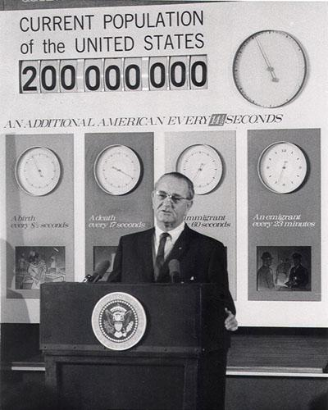
Race, Ethnicity, and the Census
Between 1930-1970: White and Other/All Other/Non-White
Parvanta, C., Nelson, D., & Harner, R. (2018). Public Health Communication Critical Tools and Strategies. Burlington, MA: Jones & Bartlett Learning, LLC

Slide 6
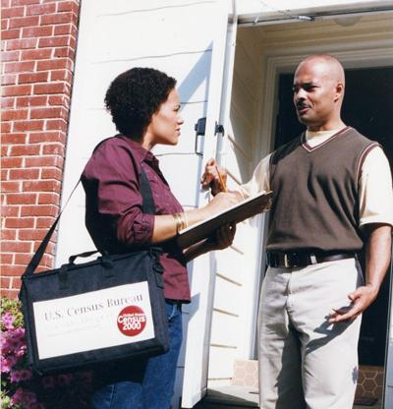
Race, Ethnicity, and the Census
1993
In 1993: the Office of Management and Budget (OMB) began to further look at classifications as the Hispanic population grew and because it was impossible to talk about vital statistics.
2000
In 2000: the new categories were used in the decennial census; other federal programs had to adopt the standard by January 1, 2003 for all data collection mechanisms.
Parvanta, C., Nelson, D., & Harner, R. (2018). Public Health Communication Critical Tools and Strategies. Burlington, MA: Jones & Bartlett Learning, LLC

Slide 7
Office of Management and Budget (OMB) Standards
Ethnic Categories
Hispanic or Latino
Racial Categories
American Indian or Alaska Native
Asian
Black or African American
Native Hawaiian or Other Pacific Islander
White
The race and ethnic categories are presented as separate questions, and individuals can select multiple racial categories. The OMB standards have one category for ethnicity—Hispanic or Latino—and five minimum categories for data on race.
https://www.govinfo.gov/content/pkg/FR-1997-10-30/pdf/97-28653.pdf

Slide 8
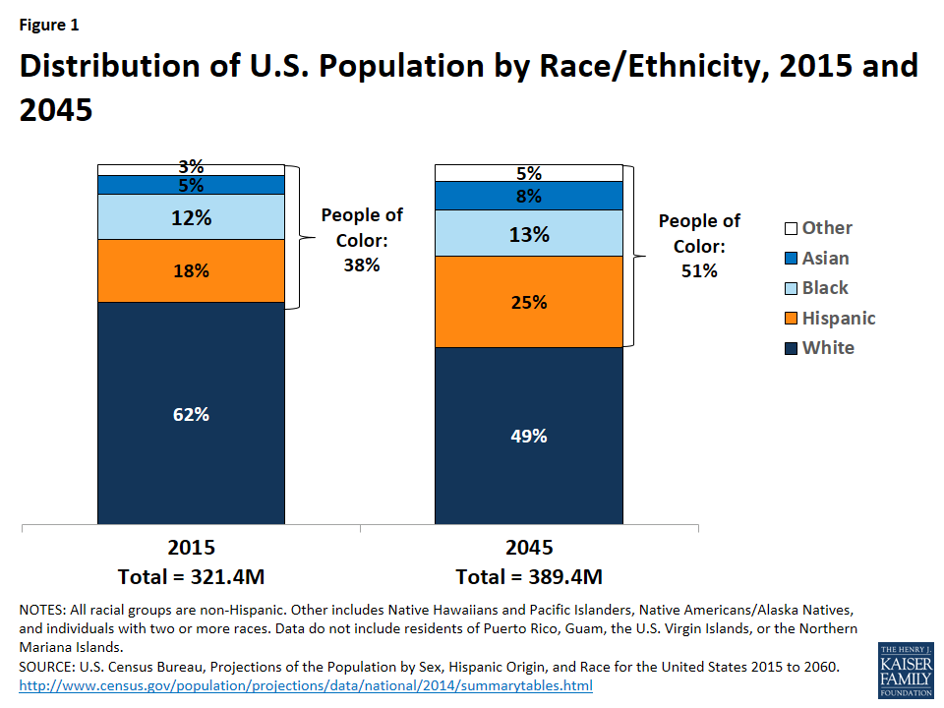

Slide 9
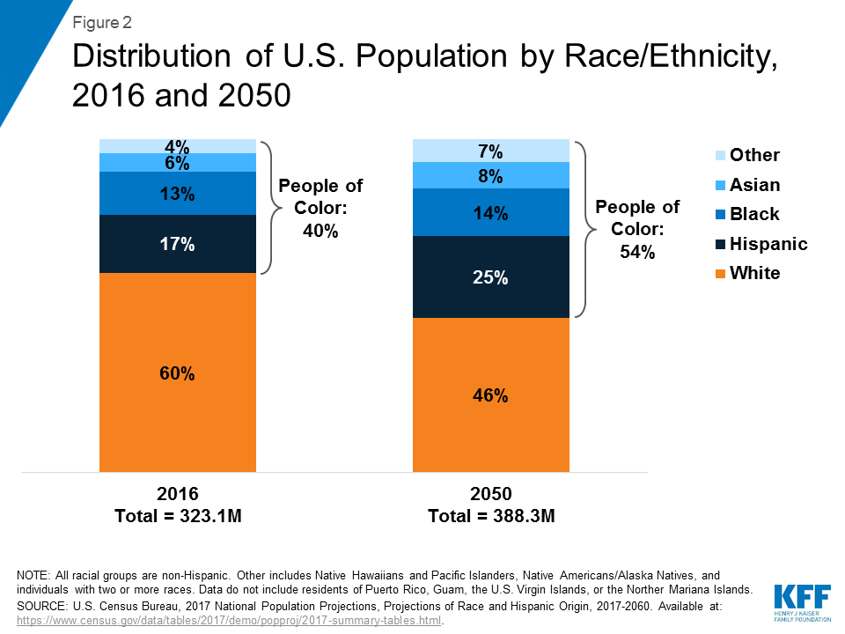

Slide 10
Terms and Definitions

Slide 11
Defining Health Disparities
In the United States the term most often used is racial and ethnic health disparities. Yet there is no clear definition of this term nor is their uniformity on how to measure these disparities.

Slide 12
Health Inequalities
Is another term used to designate difference, variations, and disparities in the health achievements of individuals and groups (Kawachi, Subramanian & Almeida-Filho, 2002).
Inequality in health is a concept commonly used in some countries to indicate systematic, avoidable, and important differences (Whitehead, 1991).
In the UK and other parts of Europe the term health inequalities refers to differences in health among people with different positions in socioeconomic hierarchy.

Slide 13
Health Inequalities
The word inequality implies a much stronger moral positioning and justice imperative that the term disparity used in the U.S.
The idea that equality is something to be sought speaks to the underlying notion that a state of inequality is due to a societal problem or malfeasance.
In contrast, the word disparity seems to have a more neutralizing effect, inferring that observed differences may or may not be caused by amendable forces.

Slide 14
Health Equity
Many have credited Margaret Whitehead with enunciating the first concrete definition of the term health equity (Braveman, 2006).
Whitehead’s definition holds that the term inequity has a moral and ethical dimension.
It refers to differences that “are not only unnecessary and avoidable but, in addition, are considered unfair and unjust” (Whitehead, 1991).
In her opinion, before we can categorize a given situation as inequitable, the cause must first be examined and judged unfair in the situational context of the larger society.

Slide 15
Defining Health Disparities
Since the mid-1990s, when the term first came into popular use, health disparities has generally been assumed to refer to health or health care differences between racial groups (Braveman, 2006).
Health disparities also refer to differences in morbidity, mortality and access to health care among population groups defined by factors such as socioeconomic status (SES), gender, residence and especially race or ethnicity (Dressler, Oths & Gravlee, 2005).

Slide 16
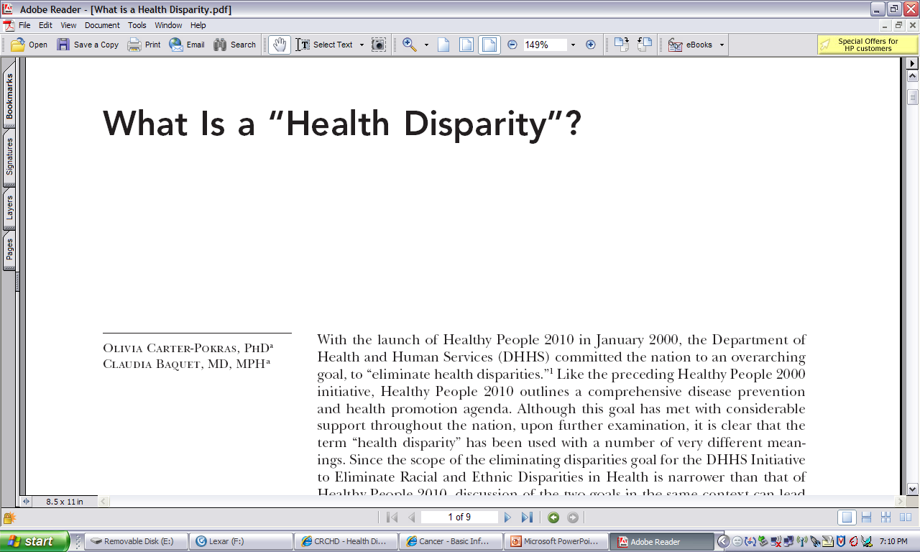
Defining Health Disparities
Carter-Pokras & Baquet (2002). What Is a “Health Disparity”? Public Health Reports, 117, p. 426

Slide 17
Defining Health Disparities
September 1999
“Health disparities are differences in the incidence, prevalence, mortality, and burden of diseases and other adverse health conditions that exist among specific population groups in the United States.”

Slide 18
Defining Health Disparities
In 2000, U.S. Public Law 106-525
Minority Health and Health Disparities Research and Education Act
“A population is a health disparity population if there is a significant disparity in the overall rate of disease incidence, prevalence, morbidity, mortality or survival rates in the population as compared to the health status of the general population.”
P.2498

Slide 19
Disparities
Most often identified along racial and ethnic lines and the different disease and survival rates
African Americans
Hispanics/Latinos
American Indians and Alaska Natives
Asian Americans
Native Hawaiians and Pacific Islanders
Whites

Slide 20
Disparities
Are also identified by:
Socioeconomic status
Income, Wealth, Poverty
Education, Occupation
Geographic status
Environment (where one works and/or lives)
Age
Gender
Insurance status
Immigration status
Health literacy status
Sexual Orientation
NIH has defined health disparity populations in the following categories: racial and ethnic minorities, low income and rural
Notes:
SES: Socioeconomic status (SES) is among those most frequently implicated as a contributor to the disparities in health observed among U.S. populations.
SES, as it relates to health status/healthcare, is an attempt to capture an individual's or group's access to the basic resources required to achieve and maintain good health.
Socioeconomic status (SES) measures a person’s social, economic, and work status.
Social status is measured by how many years a person spent in school.
Economic status is measured by how much money a person earns each year.
Work status is measured by a person’s job.
Geographical disparities:
Location
Zip codes
Health care services
Markets
Activities
Health literacy: “the degree to which individuals have the capacity to obtain, process, and understand basic health information and services needed to make appropriate health decisions.”

Slide 21
The Landmark Report

Slide 22
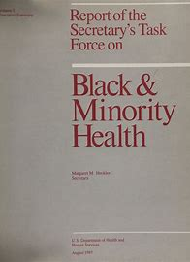
Report of the Secretary's Task Force on Black and Minority Health (Heckler Report)
The year 2015 marked the 30th anniversary of the Report of the Secretary's Task Force on Black and Minority Health (also known as the Heckler Report), released in 1985 under the leadership of then U.S. Department of Health and Human Services (HHS) Secretary Margaret M. Heckler.
The landmark report marked the first convening of a group of health experts by the U.S. government to conduct a comprehensive study of racial and ethnic minority health and elevated minority health onto a national stage.

Slide 23
Heckler Report
The Heckler Report documented persistent health disparities that accounted for 60,000 excess deaths each year and synthesized ways to advance health equity.
The report presented quantitatively that African Americans, Hispanics, Native Americans, and other minorities had poorer outcomes in areas such as life expectancy, infant mortality and low birth weight, cancer, cardiovascular and cerebrovascular disease, diabetes, and even homicide and unintentional injuries.
It also revealed the need to improve data collection among Hispanic, Asian American, and American Indian/Alaska Native populations where national health data were limited or lacking.

Slide 24
Heckler Report – The Recommendations
The report presented many recommendations, including but not limited to:
a) emphasizing prevention and primary care;
b) expanding prenatal Medicaid benefits;
c) increasing minority communities’ access to health professionals and medical care;
d) increasing collaborative efforts of state and local governments, professional associations, and other health-related organizations;
e) improving data quality; and
f) a research agenda that would increase risk factor identification, focus on health education, and elucidate the relationship between sociocultural factors and health.

Slide 25
Heckler Report - Impact
This marked the beginning of a new era in addressing minority health issues, beginning with the creation of the HHS Office of Minority Health in 1986 and leading up to the Affordable Care Act in 2010.
The Heckler Report influenced many milestones in the health equity movement:
pivotal legislation, funding, policies, research, and initiatives focused on minority health and health equity;
establishment of offices of minority health within NIH, the Centers for Disease Control and Prevention, and the Health Resources and Services Administration;
more inclusive data collection techniques;
dedicated institutions, centers, commissions, and state, territorial, and local offices of minority health across the country; and
innovative community-level interventions.
Healthy People 2000 and 2010 set goals of reducing or eliminating health disparities. Healthy People 2020 and 2030 set the goal of achieving health equity and eliminating health disparities.

Slide 26
Black Population Before and After Heckler Report (Census Years 1980 and 2010)
Census data on race:
Collected for more than two centuries.
Did not include ethnic groups until the 1970s.
Was not precisely defined for non-Whites.
Was self-reported in 1980 and 2010.
Office of Management and Budget racial groups:
Defined five categories in 1997:
White.
Black or African American.
American Indian or Alaska Native.
Asian.
Native Hawaiian.
Added sixth category (Some Other Race) in 2010 and allowed people to identify more than one race

Slide 27
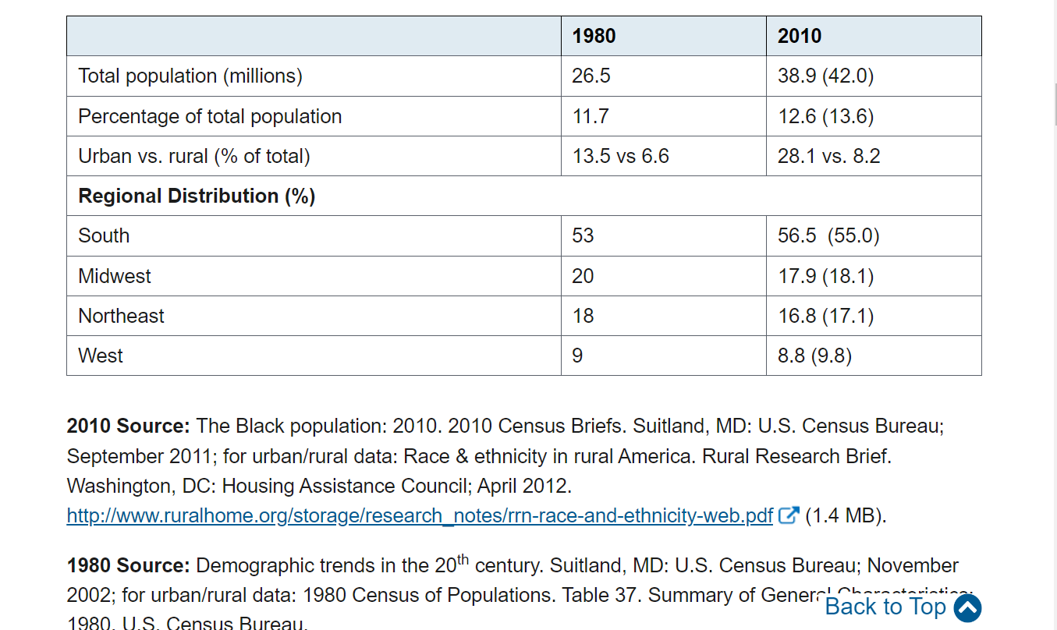
U.S. Black Population, 1980 vs. 2010

Slide 28
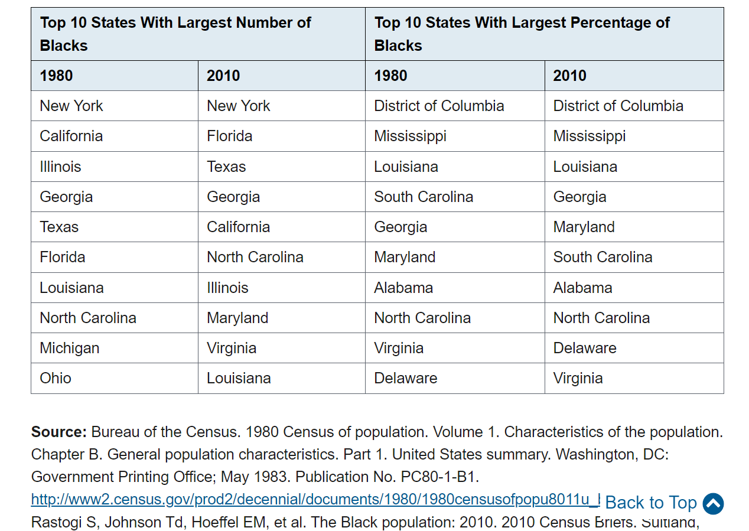
Geographic Distribution of the U.S. Black Population

Slide 29
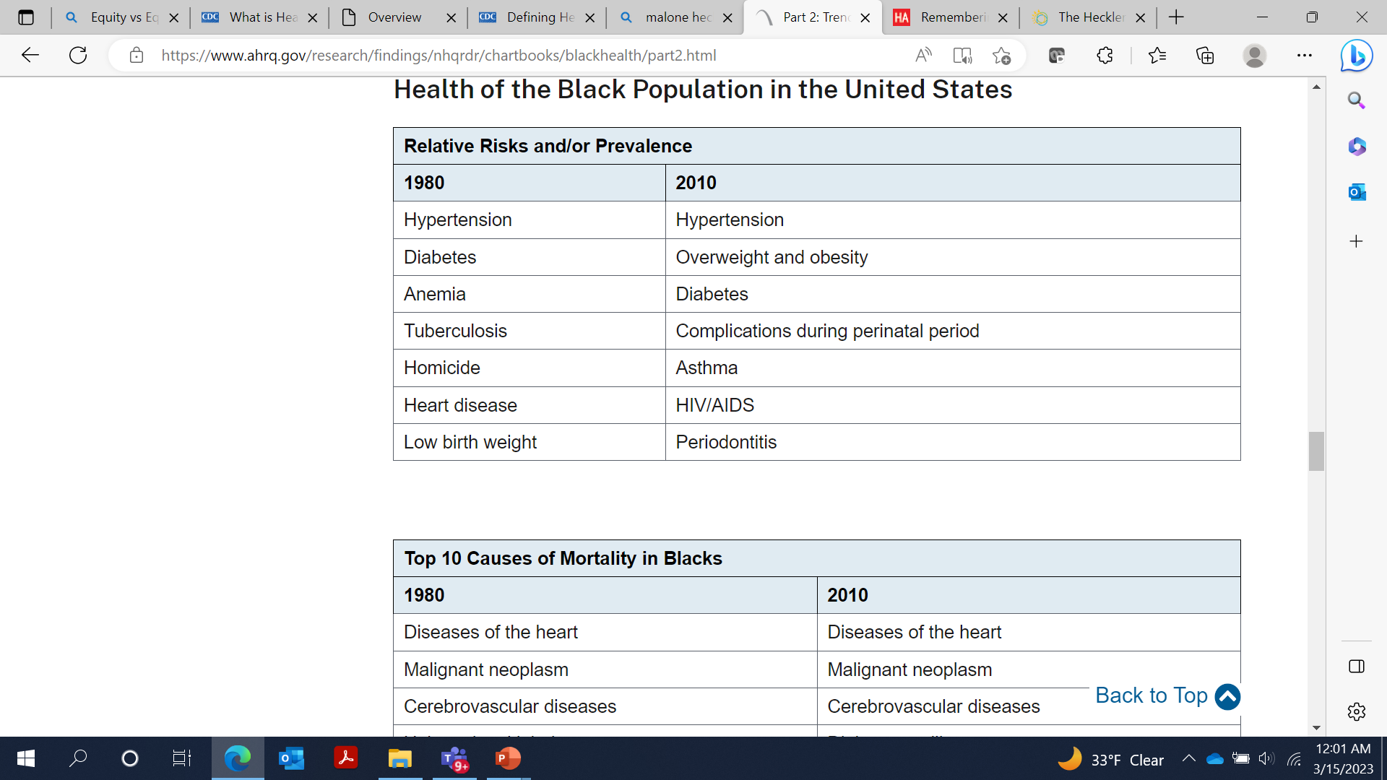
Health of the Black Population in the United States
https://www.ahrq.gov/research/findings/nhqrdr/chartbooks/blackhealth/part2.html

Slide 30
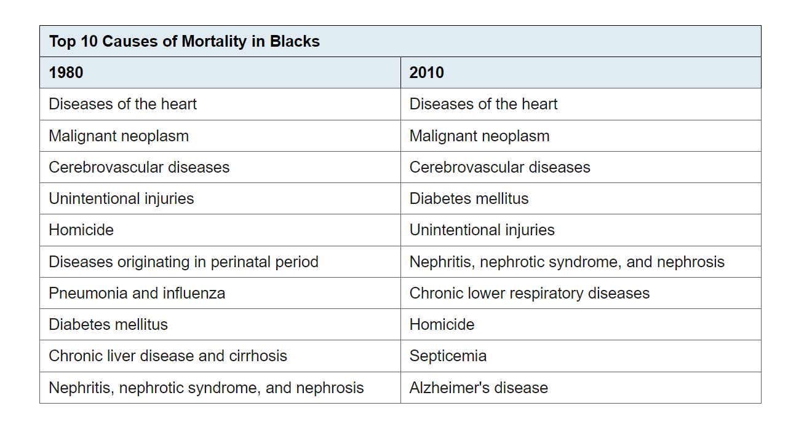
Health of the Black Population in the United States
https://www.ahrq.gov/research/findings/nhqrdr/chartbooks/blackhealth/part2.html

Slide 31
Health Equity

Slide 32
Health Equity
Health equity is the state in which everyone has a fair and just opportunity to attain their highest level of health. Achieving this requires ongoing societal efforts to:
Address historical and contemporary injustices;
Overcome economic, social, and other obstacles to health and health care; and
Eliminate preventable health disparities.

Slide 33
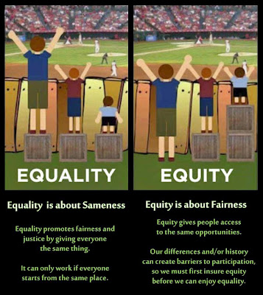

Slide 34
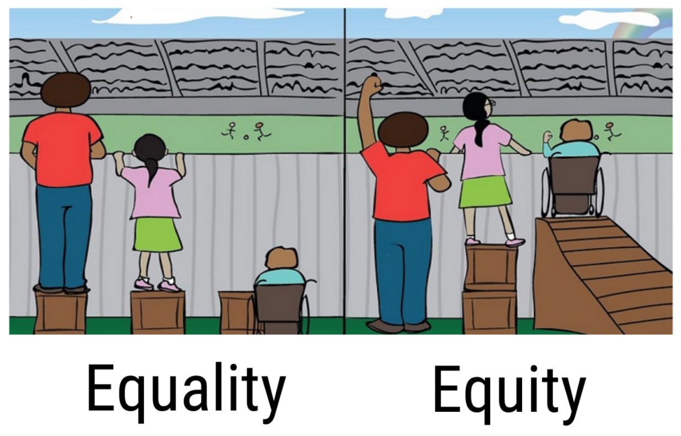

Slide 35
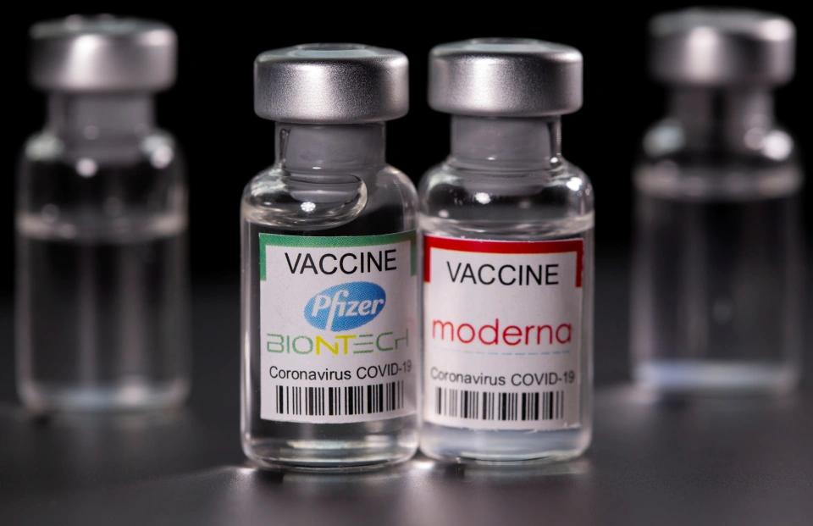
Health Equity Example

Slide 36
Health Equity and You

Slide 37
Simply Put
Health disparities are preventable differences in the burden of disease, injury, violence, or opportunities to achieve optimal health that are experienced by populations that have been disadvantaged by their social or economic status, geographic location, and environment.[1]
Many populations experience health disparities, including people from some racial and ethnic minority groups, people with disabilities, women, people who are LGBTQI+ (lesbian, gay, bisexual, transgender, queer, intersex, or other), people with limited English proficiency, and other groups.
Office of Disease Prevention and Health Promotion. (2021, August 11). Healthy People 2020: Disparities. U.S. Department of Health and Human Services. Retrieved August 13, 2021, from https://www.healthypeople.gov/2020/about/foundation-health-measures/Disparities

Slide 38
Simply Put
Across the country, people in some racial and ethnic minority groups experience higher rates of poor health and disease for a range of health conditions, including diabetes, hypertension, obesity, asthma, heart disease, cancer, and preterm birth, when compared to their White counterparts.
For example, the average life expectancy among Black or African American people in the United States is four years lower than that of White people.[3]
These disparities sometimes persist even when accounting for other demographic and socioeconomic factors, such as age or income.
Centers for Disease Control and Prevention. Impact of Racism on our Nation’s Health. 2021 [cited 2021 Nov 12]. available from https://www.cdc.gov/healthequity/racism-disparities/impact-of-racism.html.

Slide 39
Simply Put
Communities can prevent health disparities when community- and faith-based organizations, employers, healthcare systems and providers, public health agencies, and policymakers work together to develop policies, programs, and systems based on a health equity framework and community needs.

Slide 40
What You Can Do to Promote Health Equity
You—as a community member or member of an organization—can join the effort to ensure that all people have equitable access to resources to maintain and manage their physical and mental health, including easy access to important information, goods and services, and affordable medical and mental health care.
https://www.cdc.gov/healthequity/whatis/index.html

Slide 41

Questions

Slide 42
Health Equity Video
https://www.cdc.gov/healthequity/whatis/videos/index.html

